Slide 1


Slide 2













Problem
} Confidential data leaks from databases (DB)
} 2012: hackers extracted 6.5 million hashed passwords from the DB of LinkedIn
Threat: passive DB server attacks
User 1
DB Server
SQL
User 2
Application
User 3
System administrator
Hackers
} Process SQL queries on encrypted data

Slide 3


Slide 4


Slide 5
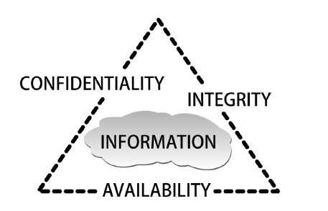
Figure 1-1 C.I.A. triangle
Courtesy Course Technology/Cengage Learning

Slide 6
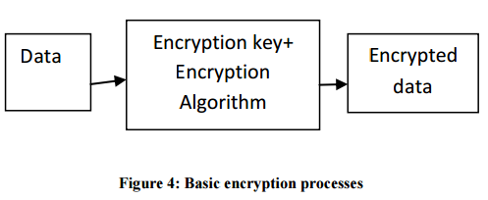

Slide 7
5.2 数据库加密的实现机制
1. DBMS提供加密功能
数据库应用
数据库管理系统
加密组件
数据库
未加密数据
加密数据
密钥信息

Slide 8
5.2 数据库加密的实现机制
2. 库外加密
数据库应用
数据库管理系统
密码服务器
(密钥管理)
数据库
未加密数据
加密数据

Slide 9
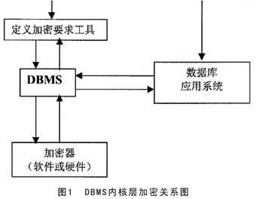

Slide 10
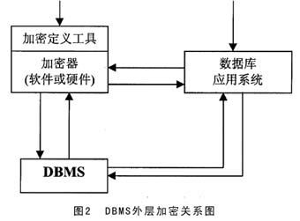

Slide 11
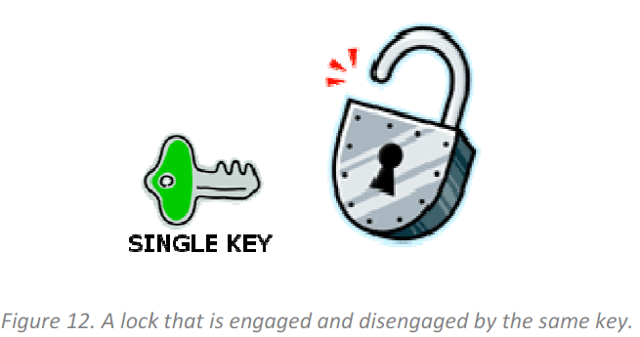
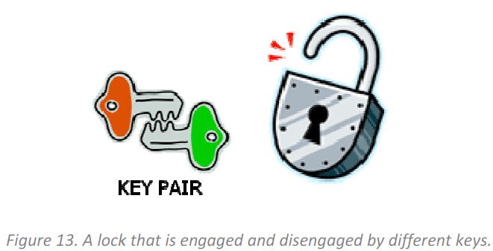
}

Slide 13
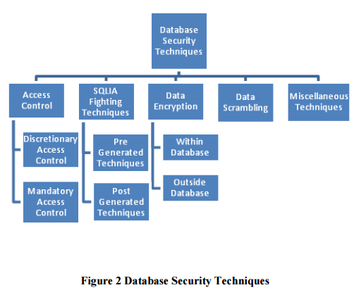

Slide 14
 | Data Encryption Within Database | Data Encryption Outside Database
Performer | DBMS | Specialized Encryption Server
Transparent Data encryption | Yes | No
Effect for Server’s Function | Affect | No
Encryption Key Management | Stored in database Big Risk | Special protection Small Risk
Effect for DBMS Function | No | Affect some functions (e.g. index)
Encryption Algorithm | Limit | Many

Slide 15
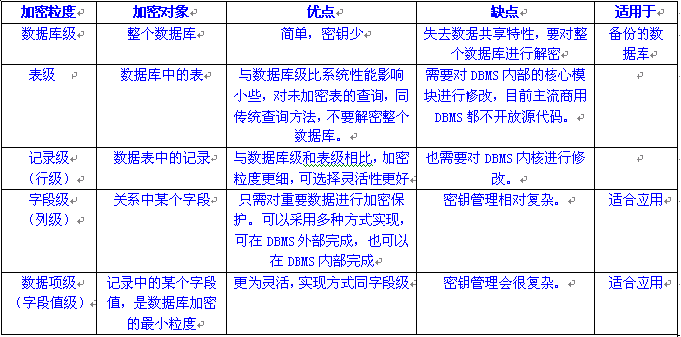
5.3 关键影响因素
1.加密粒度的比较

Slide 16
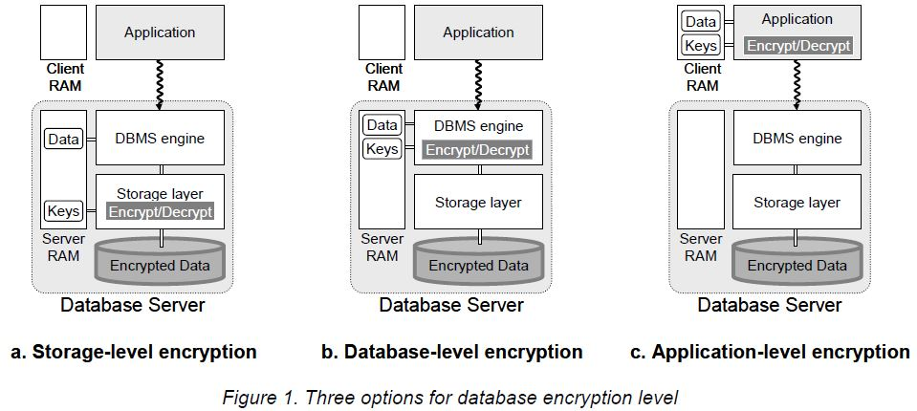

Slide 17
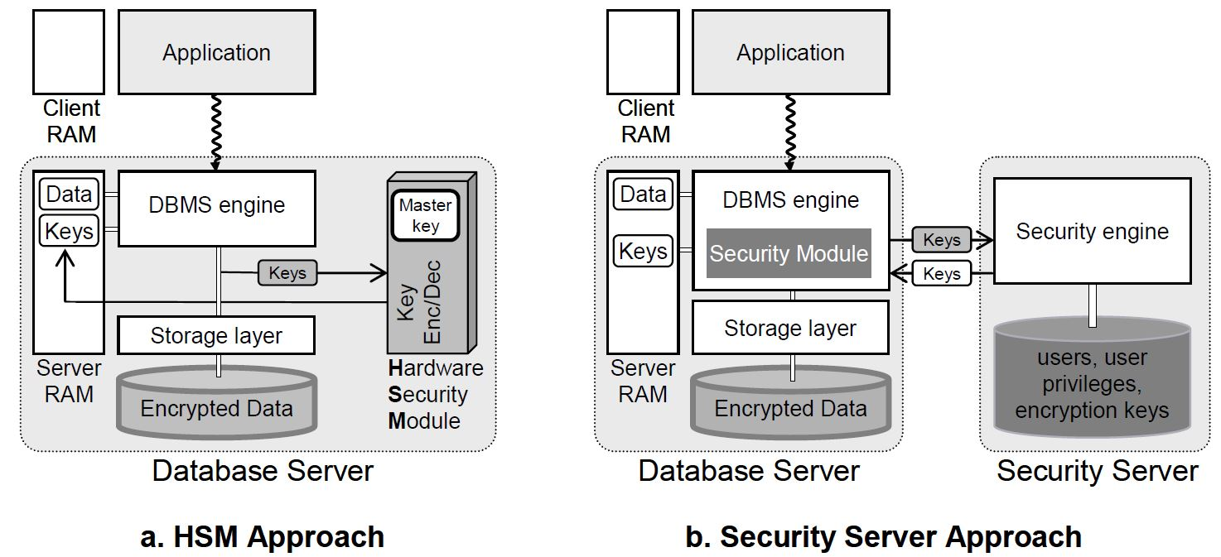

Slide 18

HSM

Slide 19
DBMS_OBFUSCATION_TOOLKIT
Introduced in Oracle 8i
Uses DES algorithm

Slide 20
Syntax
DBMS_OBFUSCATION_TOOLKIT.DES3Encrypt(
input_string IN VARCHAR2,
key_string IN VARCHAR2,
which IN PLS_INTEGER DEFAULT TwoKeyMode
iv_string IN VARCHAR2 DEFAULT NULL) RETURN VARCHAR2;
DBMS_OBFUSCATION_TOOLKIT.DES3DECRYPT(
input_string IN VARCHAR2,
key_string IN VARCHAR2,
which IN PLS_INTEGER DEFAULT TwoKeyMode
iv_string IN VARCHAR2 DEFAULT NULL) RETURN VARCHAR2;

Slide 21
DBMS_CRYPTO
Released in Oracle 10.1
Supports AES
Provides automatic padding
Different options for block chaining
Support for CLOB and BLOB
Will deprecate dbms_obfuscation_toolkit

Slide 22
Transparent Data Encryption (TDE)
Introduced in Oracle 10.2
– column encryption
Enhanced in Oracle 11.1
- tablespace encryption

Slide 23
How is TDE Implemented?
1 Setup Wallet and Master Key
2 Identify columns with sensitive data
3 Review constraints
4 Encrypt existing and new data

Slide 24
Standard encryption and hashing algorithms used by TDE

Slide 25
Managing and rotating TDE master keys using Oracle Enterprise Manager

Slide 26
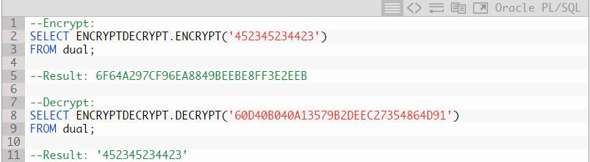

Slide 27
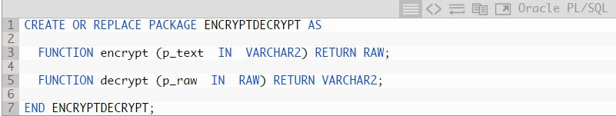

Slide 28
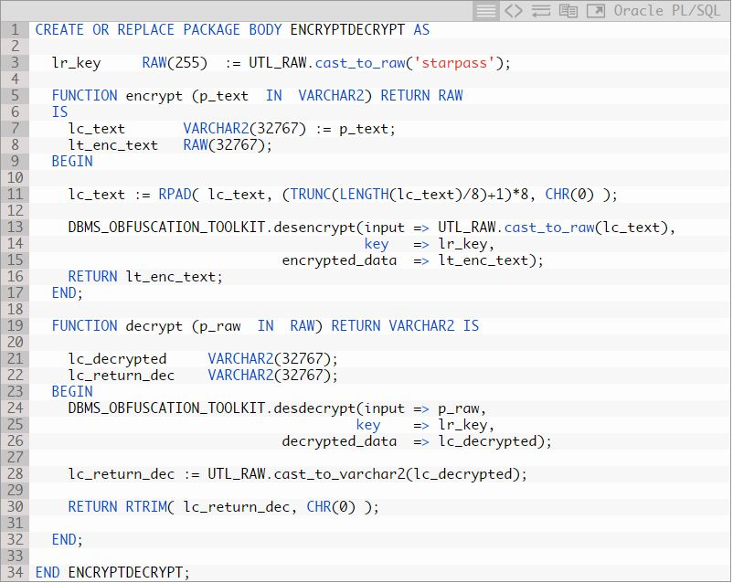

Slide 29
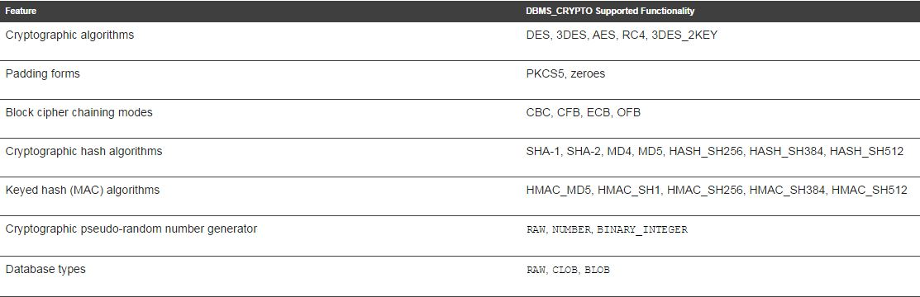
Table DBMS_CRYPTO Package Feature Summary

Slide 30
SQL Server Layer | ANSI X9.17 Layer | Description
SMK | Server Master key | The SMK is the top-level key used to encrypt the DMK. The SMK is encrypted by the Windows DPAPI.
DMK | Database encrypting key | The DMK is a symmetric key that’s used to encrypt a symmetric key, asymmetric key, and certificates. Only one DMK can be defined for each database.
Symmetric keys, asymmetric keys, and certificates | Data key | Symmetric keys, asymmetric keys, and certificates are used to encrypt data.
Table SQL Server and ANSI X9.17 Encryption Key Layers

Slide 31
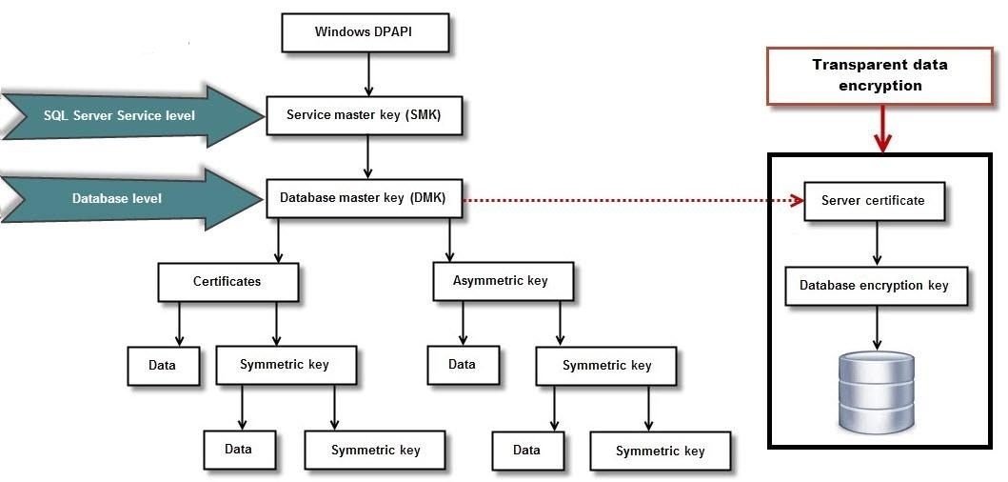

Slide 32
Name | Description
Aes_Decrypt() | Decrypt using AES
Aes_Encrypt() | Encrypt using AES
Compress() | Return result as a binary string
Decode() | Decodes a string encrypted using ENCODE()
Des_Decrypt() | Decrypt a string
Des_Encrypt() | Encrypt a string
Encode() | Encode a string
Encrypt() | Encrypt a string
Md5() | Calculate MD5 checksum
Old_Password() | Return the value of the pre-4.1 implementation of PASSWORD
Password() | Calculate and return a password string
Random_Bytes() | Return a random byte vector
Sha1(), Sha() | Calculate an SHA-1 160-bit checksum
Sha2() | Calculate an SHA-2 checksum
Uncompress() | Uncompress a string compressed
Uncompressed_Length() | Return the length of a string before compression
Validate_Password_Strength() | Determine strength of password
Table: MySQL Encryption Functions

